Slide 1
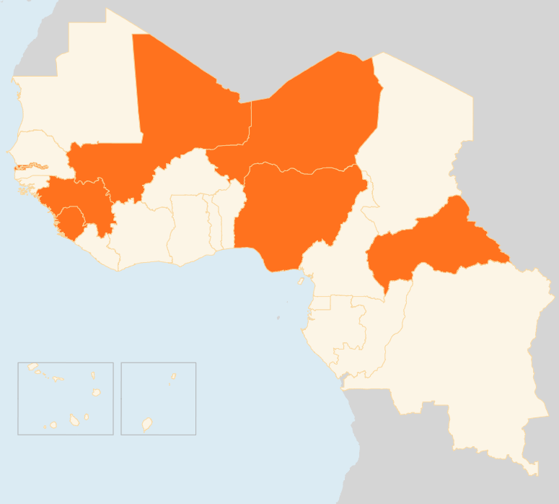


19 - 25 May 2015
CENTRAL AFRICAN REPUBLIC
4,400 DISPLACED BY ATTACKS
Around 1,900 IDPs and 2,500 residents in Bissingalé locality have been forced to flee to the nearby Kaga-Bandoro town in the north of the country following armed attacks by unknown gunmen on Site-Nana, Bissingalé and Ndémayo villages in Kaga-Bandoro on the night of 15 May. Ten people were killed in the raid which happened five days after the signing of an agreement between armed groups and the government to end hostilities and begin a disarmament, demobilisation and reintegration process.
MALI
27,000 FLEE ARMED RAIDS
As of 21 May, armed attacks had forced a total of 26,983 people from their homes in Timbuktu region. The attackers looted homes and business and stole livestock. The displaced have sought refuge in more populated areas in the south of Niger river, where they are staying in temporary shelters, camping or with host families and are in urgent need of water, food, non-food items and shelter. Humanitarian actors in the region are positioning relief items to deliver. A needs assessment and food distribution are ongoing.
NIGER
238 ARRIVE FROM MALI FLEEING VIOLENCE
A total of 238 displaced people have arrived in Niger’s Tillabery region since 21 May from Tin Hama in the Gao region of Mali due to fighting and alleged executions. On the Malian side, a food and NFI response is underway led by the Ministry of Solidarity Affairs and supported by humanitarian actors. UNHCR facilitated the reception of the displaced through its partners at the border-crossing to the Tillabéry region in Niger, the transport of 51 displaced to a camp and the temporary lodging of 187 in Ayorou as of 24 May.
NIGERIA
‘ALARMING’ RISE IN USE OF FEMALE SUICIDE BOMBERS
In the first five months of 2015, more women and children have been used in suicide attacks than the whole of last year, UNICEF announced on 26 May. In 2014, 26 suicide attacks were recorded, compared to 27 attacks as of May 2015. In at least three-quarters of these incidents, women and children were reportedly used to carry out the attacks. The agency expressed concern that the increasing use of children as suicide bombers could lead to children being perceived as potential threats, which would put all children associated with armed groups at risk of retaliation and would impede their rehabilitation and reintegration in their communities.
SIERRA LEONE
0 EVD CASES IN THREE CONSECUTIVE DAYS
Sierra Leone has reported no new confirmed cases in three days between 22 - 24 May, a new window of no infections after an eight-day lull earlier this month (6 - 13 May) was broken by eight confirmed cases in the week to 17 May.
GUINEA
COMMUNITY RESISTANCE IN NEW HOTSPOTS
Guinea reported five new cases between 22 - 24 May. Community resistance has hampered response in the two new EVD hotspots of Boké and Dubréka prefectures that were recently identified. A team from Guinea’s National Coordination (on Ebola) has been sent to Tanéné sub-prefecture in Dubréka to identify the cause of the outbreak and establish response strategies. Response measures are also being stepped up in Boké.
REGIONAL / EBOLA VIRUS DISEASE
5 CASES IN THREE DAYS, AFTER 35 LAST WEEK
Between 22 - 24 May, five new cases were reported in Guinea, and no new case in Sierra Leone. The week that ended on 17 May however, saw the highest weekly total of confirmed cases of Ebola for over a month, with 35 cases reported from Guinea and Sierra Leone compared to only nine cases the previous week. The geographical area of transmission also expanded, with six districts reporting cases - twice as many in the previous weeks.
MALI
27k
FLEE ARMED RAIDS
NIGER
238
ARRIVE FROM MALI
NIGERIA
STEEP RISE IN USE OF FEMALE BOMBERS
CAR
4,4k
DISPLACED BY ATTACKS
GUINEA
SIERRA LEONE
5
NEW CASES IN THREE DAYS
0
EVD CASES IN THREE DAYS
Creation date: 27 May 2015
Map data sources: UNCS, DevInfo, OCHA.
The boundaries and names shown and the designations used on this map do not imply official endorsement or acceptance by the United Nations

